Slide 1



District Health Information System (DHIS2)
Android-based Data Entry
By
Zemene Worku
1 October 2024

Slide 2
Outline
Download DHIS2 Android App
Launching Android App
Login
Data Entry
Sync Data
Setting

Slide 3
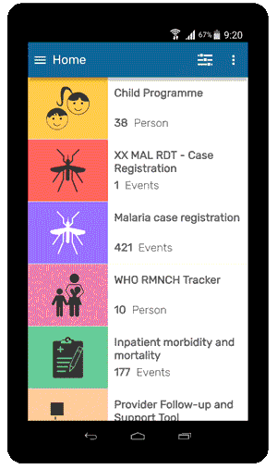
DHIS2 Android App data entery
The new generation DHIS2 Android Apps integrating events and tracker data capture
Fully functional while offline and with more features, better user interface & data protection, to improve the user experience.

Slide 4
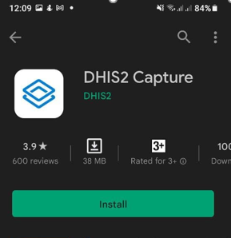
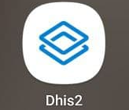
DHIS2 Android App - Download
Steps to download and install DHIS2 capture:
Connect your device to internet
Go to google Play Store and type ‘DHIS2 Capture’ in search
Press Install button
When Installation is completed, you will get the DHIS2 capture app on your device
Open dhis2 capture app

Slide 5
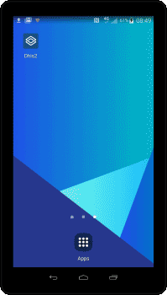
DHIS2 Android App – Launching
Connect the android phone to internet (mobile data or wifi)
Open the app and enter the url, user and password to connect to the server hosting the DHIS2

Slide 6
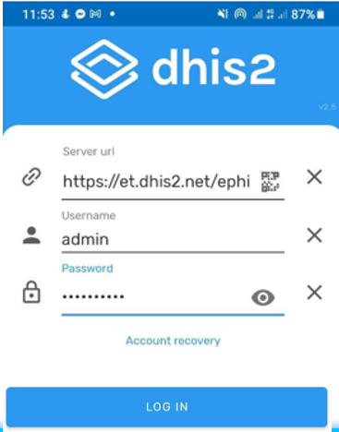
DHIS2 Android App – Login
Connect the Android device to the internet (mobile data or wifi)
Open the dhis2 app enter the server URL, username, and password, and press login to connect to the server hosting the DHIS2

Slide 7
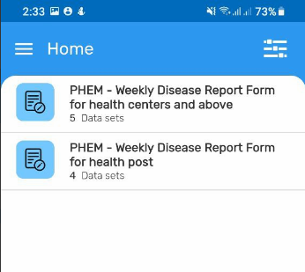

DHIS2 Android App - Data Entry
If you are from health post (HP) select PHEM – Weekly Disease Report Form for health post
Once you select the dataset you will get the Add data screen

Slide 8
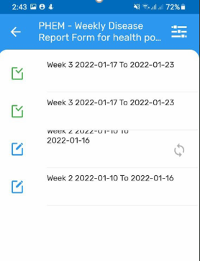

DHIS2 Android App – Data Entry
You will see the following screen if there is data entered previously
Press button to start new data entry

Slide 9

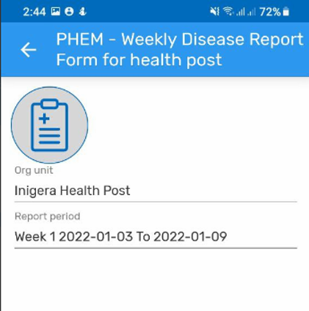

DHIS2 Android App – Data Entry
Select reporting period and Press to get data entry screen

Slide 10
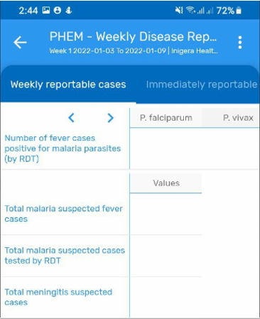
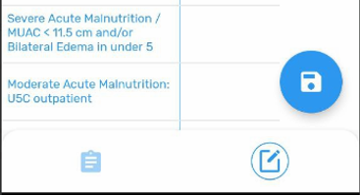
DHIS2 Android App – Data Entry
Data Entry screen
Start data entry by pressing the screen next to data elements

Slide 11
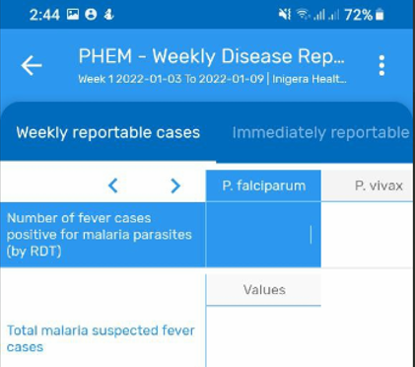

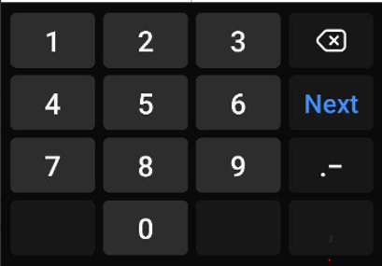
DHIS2 Android App – Data Entry
Press the screen next to data elements and you will get blue highlighted data element and the number pad will popup
Start entering data values
Press button from number pad to move to the next text box

Slide 12
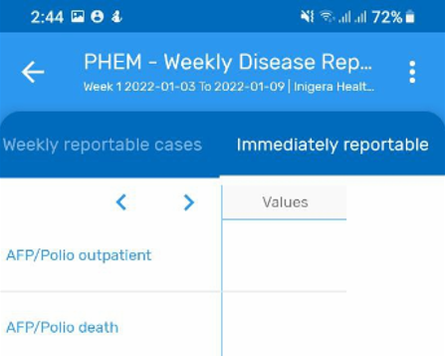

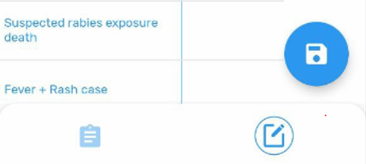


DHIS2 Android App – Data Entry
Once you complete the Weekly reportable cases, press on the Immediately reportable tab to start data entry for immediately reportable

Slide 13

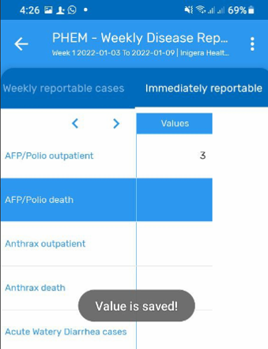
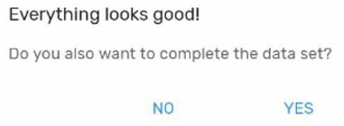

DHIS2 Android App – Data Entry
Press to check data quality and complete the data set
Press to edit data values
Press to view information about the data set, reporting period and Org unit

Slide 14

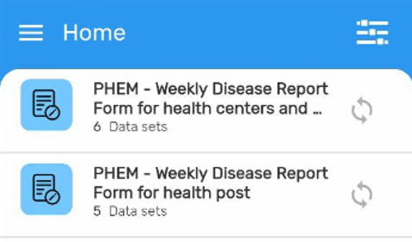
DHIS2 Android App – Data Entry
The data will be saved automatically on your device and can be synced to the server
To sync your data to the server:
  Connect to the internet
  Press an Infront of the name of a data set

Slide 15
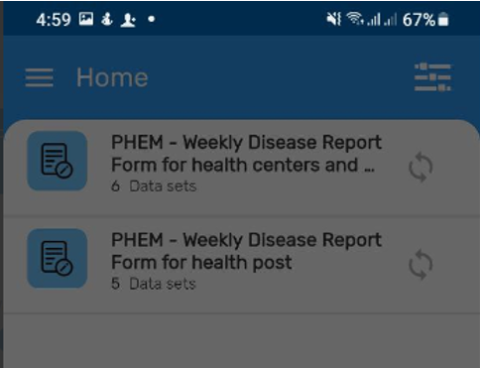
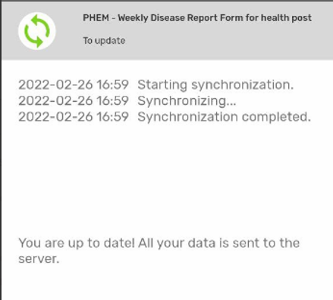
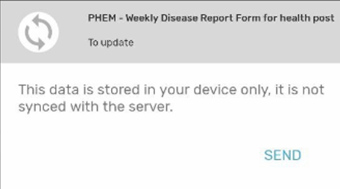
Sync Data
Press SEND to manually sync the data to the server

Slide 16
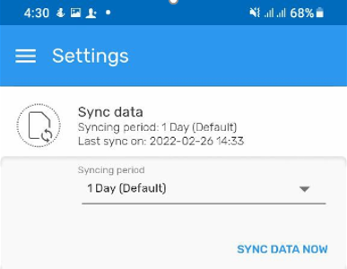

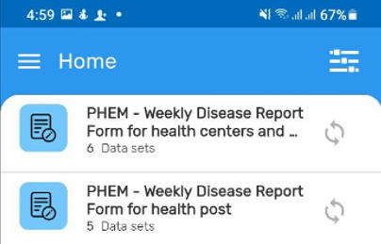
DHIS2 Android App - Setting
We can set period to send data to the server from Sync data menu under the Setting
Press to get the data capture Setting
Press setting under Menu
Press to sync data automatically

Slide 17
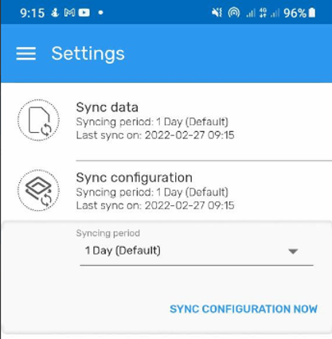
DHIS2 Android App – Setting
We can set period to send configuration information to the server from Sync configuration menu under the Setting
Press to sync configuration automatically

Slide 18
Thank you

